Slide 1


Introduction to Child & Adolescent Psychiatry
Asiri Rodrigo

Slide 2
Child & Adolescent Psychiatry
Psychiatry
The study and treatment of mental illness, emotional disturbance, and abnormal behaviour. (Oxford Dictionary)
Child & Adolescent Psychiatry
Branch of psychiatry that specializes in study, diagnosis, treatment and prevention of mental health disorders of children, adolescents and their families

Slide 3
Child & Youth Mental Health Services in Sri Lanka
Outpatient services
Teaching hospitals, General hospitals
Inpatient services
Lady Ridgeway Hospital
Number of specialists
Limited

Slide 4
Prevalence of common mental disorders in Children & Youth
Depressive disorder 15%
Anxiety disorders 15%
Attention deficit hyperactivity disorder 7%
Bipolar disorder 1%
Substance use disorders 20%
(Adolescents)

Slide 5
Burden of CYMH
Prevalence of mental health problems Children and Youth estimated at 20% (USA Surgeon General’s Report)
Half of all lifetime cases of mental illness are now recognized to begin by age 14 (Kessler et al, 2005)
The median number of years from the time a child first experiences psychiatric disturbance and receives treatment is 9 years

Slide 6

Brain: Cognitive development
Piaget’s cognitive development stages
Differentiates Self vs Non-self
World revolves around me (egocentric)
Logical thinking
Abstract thinking

Slide 7
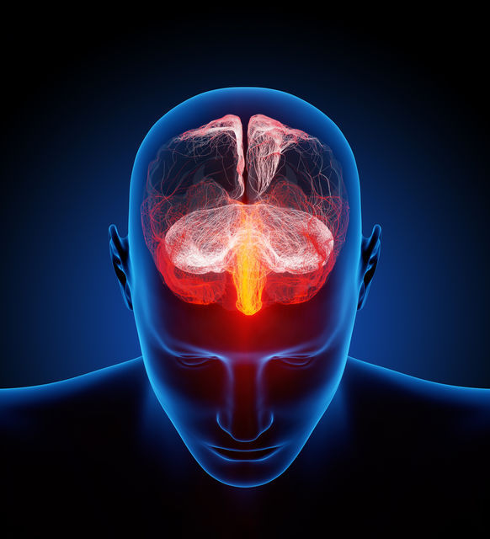
One billion neurons

Slide 8
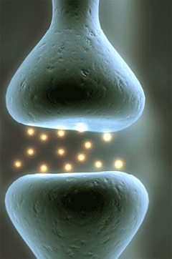
Complex single transduction using multiple neurotransmitters

Slide 9
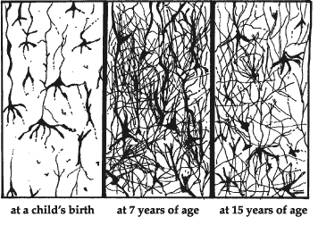
Early life Middle Childhood Youth

Slide 10
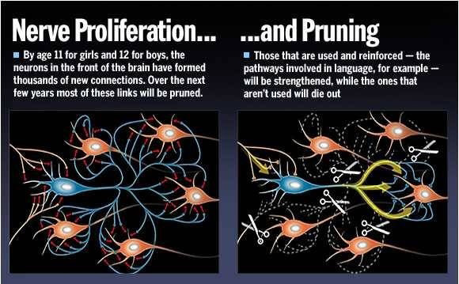
Pruning!

Slide 11
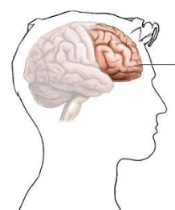
Pre-frontal cortex

Slide 12
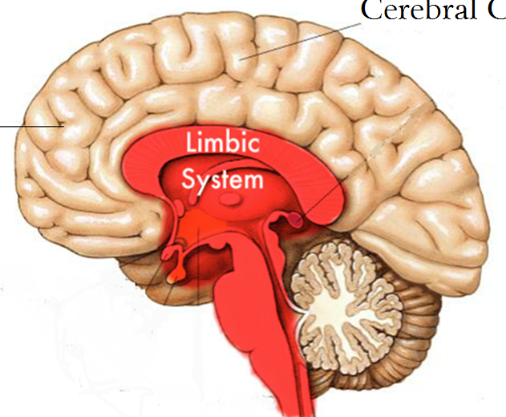
Limbic System (striatum)

Slide 13


Addictions!
Limbic system
Frontal cortex

Slide 14

Urges!
Limbic system
Frontal cortex

Slide 15
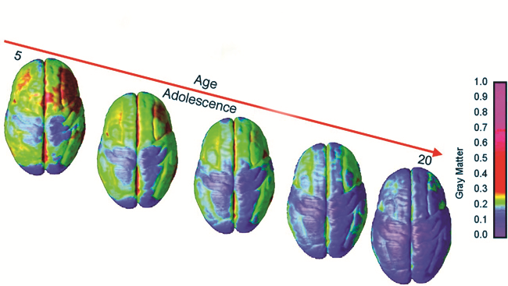
Brain maturation

Slide 16
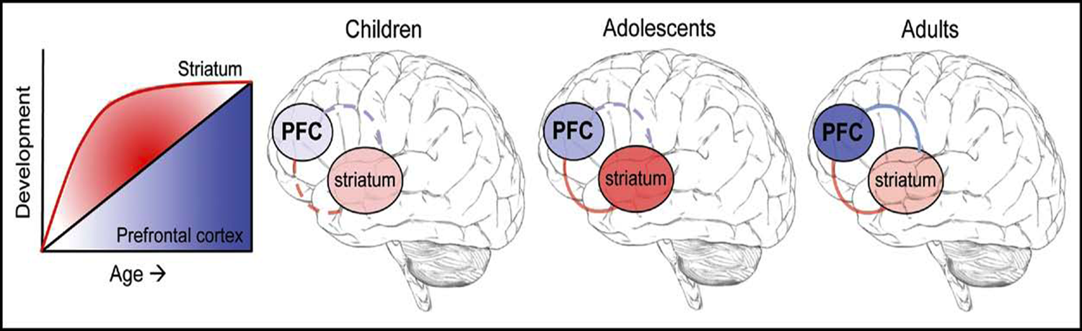
Transition of Cognitive Control

Slide 17
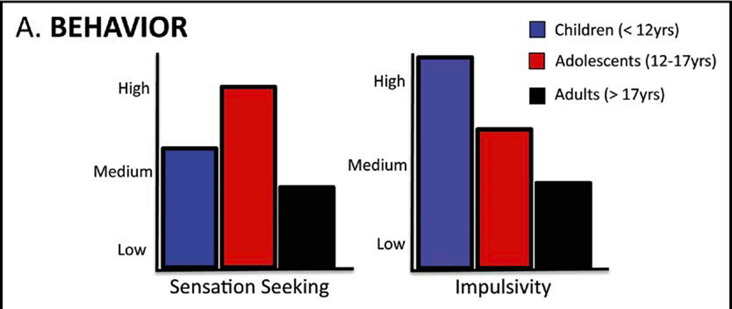
Behaviour pattern related to cerebral maturation

Slide 18
Assessment

Slide 19
Assessment of clients
Clinical interview:
History from the child/adolescent
History from the parent/guardian
Details about Birth, Development, Education, Risks
Parent’s childhood & Family background
Mental state examination
Physical examination
Learning assessment/Teacher’s information
Intelligence assessment

Slide 20

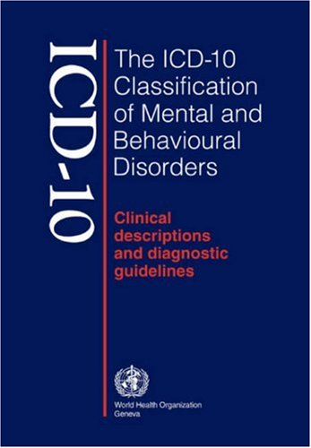
Diagnostic criteria

Slide 21
Mental Disorders in Children & Youth
Neurodevelopmental disorders
Psychotic disorders
Mood disorders
Anxiety disorders
Obsessive compulsive and related disorders
Trauma & Stress related disorders
Somatic symptom & Dissociative disorders

Slide 22
Mental Disorders in Children & Youth
Eating disorders
Elimination disorders
Sleep-wake disorders
Disruptive, Impulse control and Conduct disorders
Gender dysphoria
Substance use disorders
Paraphilic disorders

Slide 23
Neurodevelopmental disorders
Conditions with onset in the developmental period
Characterized by impairments of
Personal
Social
Academic
Occupational
Deficits varies from very specific limitations to global impairments

Slide 24
Neurodevelopmental disorders
Intellectual disability
Communication disorder
Autism spectrum disorder
Attention deficit hyperactivity disorder
Specific learning disorder
Motor/Tic disorders

Slide 25

Autism Spectrum Disorder (ASD)
Persistent deficits in social communication
Social reciprocity
Nonverbal communication
Skills in relationships
Restricted, repetitive patterns of,
Behaviour
Interests
Activities

